Slide 1

ECMAScript 6
Notes:
https://kangax.github.io/compat-table/es6/

Slide 2

JavaScript Is Nothing to do with JAVA
It is used to make webpages interactive and provide online programs.

Slide 3
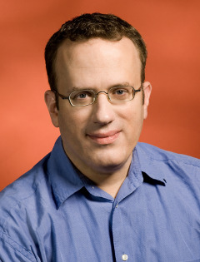
Founder Brendan Eich
Late 1995

Slide 4

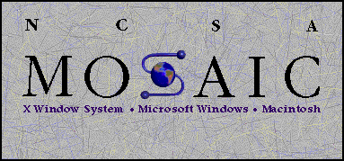

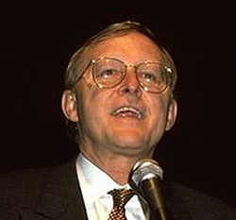
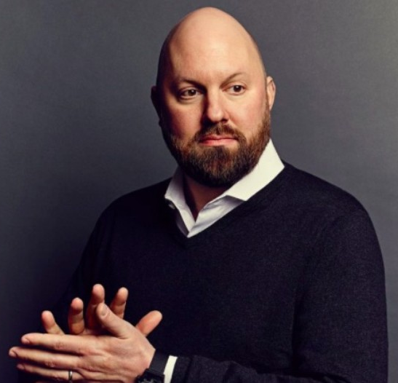
1993 introduce images
1995 Font Element And Text Decoration
Brendan Eich
James H. Clark
Marc Andreessen
Notes:
Mozaic first popular browser (images) 1993
Netscape 1995 (Mozaic Developers Head Hunting) font element and text formatting
1995 bring Berdan Eich(CTO of firefox) to developer Events

Slide 5




2 weeks
LiveScript
Notes:
Scheme 1975 => function as a First class object(Passed and returned from functions and can be property on class)
Self 1989 by Xerox => First Prototypal Programing Language (No Classes it only objects that can inherits from object).
1992 sun bye small talk (oop language) & self and create java
1995 sun decided to kill one of the types of programing => kill Prototypal (self)
Briden Eich create LiveScript from the best of the three languages

Slide 6




1995
1996
JavaScript
JScript
1997
Script

Slide 7

V1.0
V1.3 ECMAScript 1 & 2
V1.8.5 ECMAScript 5
V1.5 ECMAScript 3
V1.6 ECMAScript for XML
ECMAScript 6
ECMAScript 7
ECMAScript 8

Slide 8

Let’s Start

Slide 9
Let
Const
Variable
Declare
Variables
Notes:
1- in hoisting
2- const with variables and objects

Slide 10
Blocks & IIFES
{
let y = 5
}
Notes:
Immediately Invoked Function Expressions

Slide 11

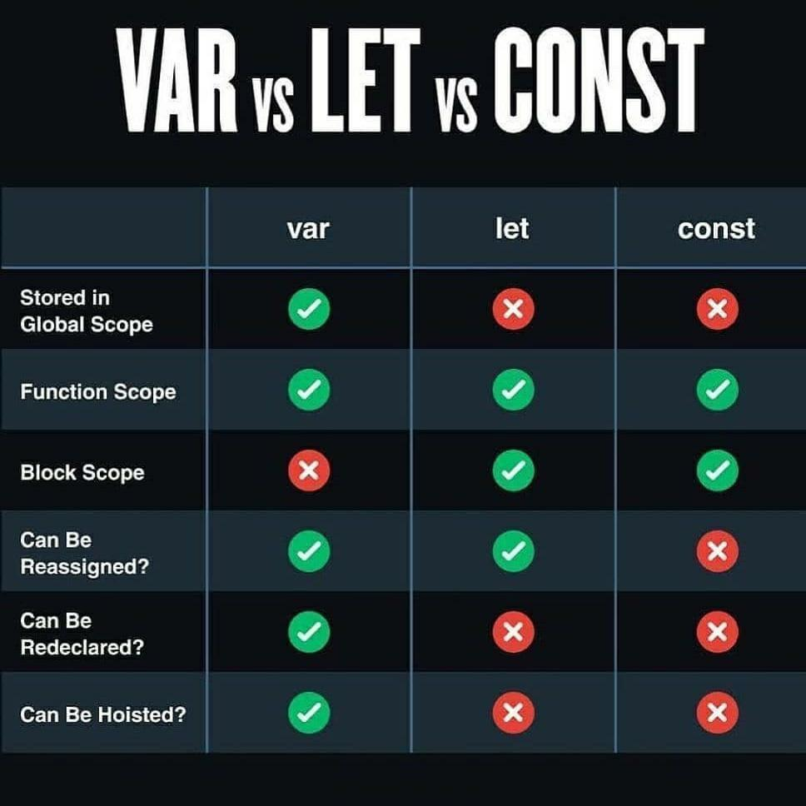
Notes:
Immediately Invoked Function Expressions

Slide 12
Strings
String.startsWith(“string”)
String.endsWith(“string”)
String.includes(“string”)

Slide 13
Template literals
`String text ${expression} String text`
Notes:
Template literals (Template strings)

Slide 14
Arrow Function
() => {statements}
Notes:
#arrow function with this

Slide 15
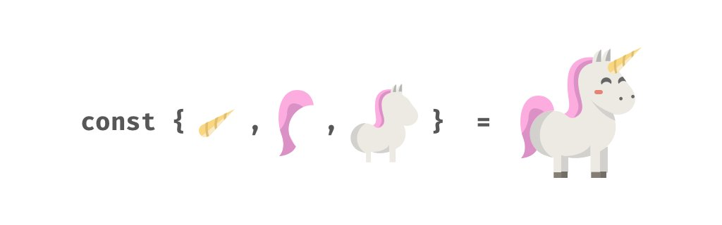
Destructuring
Arrays
&
objects

Slide 16
Default Parameters
function myFunction(param = default value, param2 =default value2)
{
//statements
}

Slide 17

Array.from()
For (el of arr){ statements }
Array.find()
Array.findIndex()
Array.filter()
Array.reduce()
Array.map()
Array

Slide 18
Questions ???

